Slide 1


A deep learning approach to
SENTIMENT
ANALYSIS
FROM
TEXT
IN
PYTHON
Osagie Elliot aibangbee
https://editor.analyticsvidhya.com/uploads/49704Capture6.PNG
MARCH 15, 2022.
Notes:
INTRO:
Welcome to Deep Learning-based Sentiment Analysis From Text in Python.

Slide 2
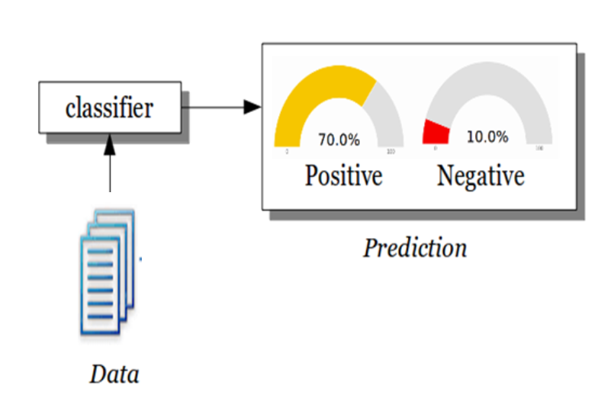
AIM AND OBJECTIVE
To identify the feeling/opinion conveyed by each writer from a large volume of social text data.
Implement and compare performances of different machine learning models on this task.
Recommend a good model architecture based on my experimental findings.
https://pythonspot.com/wp-content/uploads/2016/08/sentiment-analysis-example.png
Notes:
PROBLEM:
For better customer relationships, businesses need to efficiently interpret customer feedbacks.
These feedbacks often come in the form of text.
Therefore, businesses need a way to quickly analyze large volumes of text data.
SOLUTION:
To address this, I shall implement and compare several architectures of machine learning algorithms.
These models shall identify one of two sentiments in each text.

Slide 3
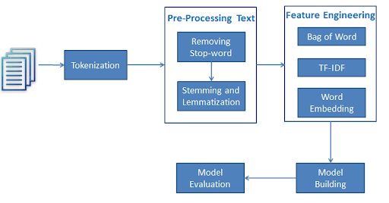
OVERVIEW
Some useful questions for sentiment analysis in business:
  What are customers complaining about or pleased with?
  What do people think of our products/services?
  How can we quantify customer satisfaction?
We shall be using machine learning and deep learning models to identify different sentiments in financial text data. That is, decide if the writer was pleased or not pleased.
http://res.cloudinary.com/dyd911kmh/image/upload/f_auto,q_auto:best/v1535125878/NLTK3_zwbdgg.png
Notes:
Many steps are involved in developing a machine learning algorithm to identify sentiment from text data.
Including:
Tokenization,
Removal of stop words,
Creation of word vectors,
Building and training the model,
Evaluation of model performance.
Model deployment.

Slide 4
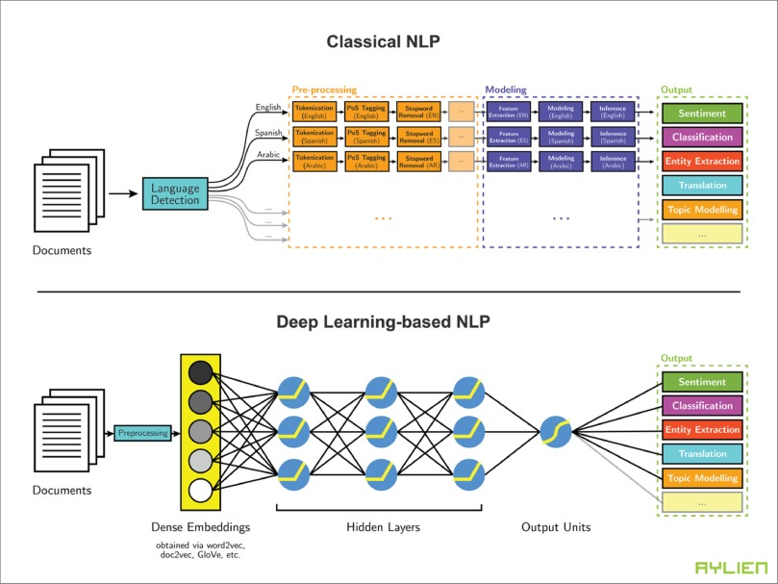
EXPERIMENTAL APPROACHES:
Some Deep Learning Methods:
  Convolutional Neural Network
  Simple Recurrent Neural Network
  Long Short-Term Memory
  Gated Recurrent Unit
Other Machine Learning Methods:
  Logistic Regression
  Support Vector Machine
  Naïve Bayes Classifier
https://ars.els-cdn.com/content/image/1-s2.0-S0957417418306456-gr3.jpg
Notes:
I’ll experiment with each of these algorithms and compare training duration.
Metrics like accuracy, precision, recall and f1_score shall be used to evaluate model performance.

Slide 5
CONCLUSION
Watch out for my project report in which I shall discuss my findings in detail.
THANK YOU.
Notes:
Watch out for my project report in which I shall discuss my findings in details.
Thank you.

